Slide 1
Samsung
Innovation
Campus
Artificial Intelligence Course

Slide 2
Brain Tumor Detection
Egypt,
14-Nov-2022

Slide 3
Our Team
Injy ElSherbini
Computer Science student.
Nourhan Mahmoud
Engineering student.
Ziad Omar
Engineering student.
Our facilitator.

Slide 4
TABLE OF CONTENTS
Introduction
Data Description
1
2
A brain diagnosing a brain?
What info do we have?
Some Statistics
Preprocessing & Modeling
What do numbers tell us?
3
4
How did we deal with the all these data?
Deployment
Conclusions
How can patients benefit from our work?
5
6
Final words..

Slide 5
Introduction
1
A brain diagnosing a brain?

Slide 6
Our Brain
The most complex organ of our body and therefore, the most important.
Contains billions of neural networks that interact to create human behavior.

Slide 7
ABOUT BRAIN TUMOR (Primary)
There are three types of primary brain tumors, about which we are concerned throughout this project:
Glioma
Meningioma
Pituitary Adenoma

Slide 8
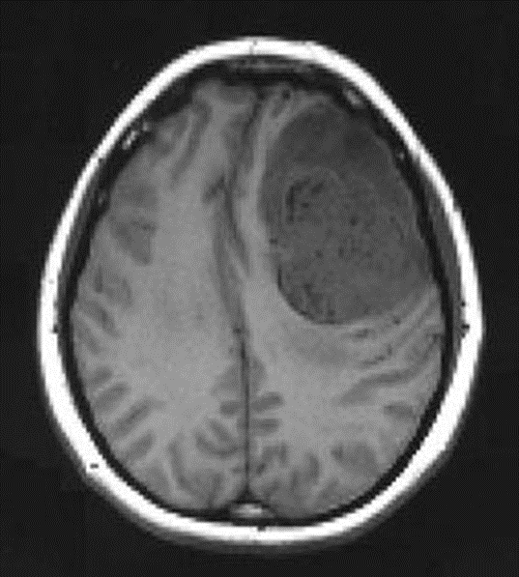
Glioma
Arise from the glial cells which surround the nerve cells in the brain.
They are the most numerous cells in the central nervous system.
(Left is right, right is left, bone is bright white, malignant tumor with contrast dye is grey) Midline shift, Google Images, http://www.ispub.com/xml/journals/ija/vol8n2/pregnant-fig1.jpg

Slide 9
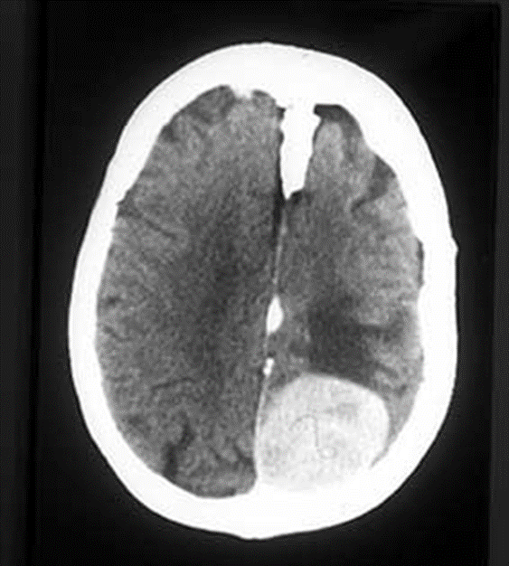
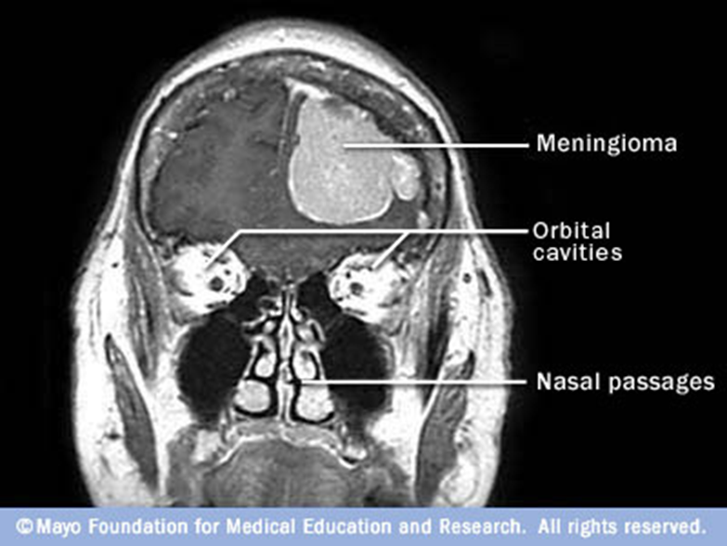
Meningioma
Most common type of primary tumor.
Arises from the meninges = the lining of the brain.
Google Images, www.student.bmj.com (Left is right, right is left, bone is bright white)

Slide 10
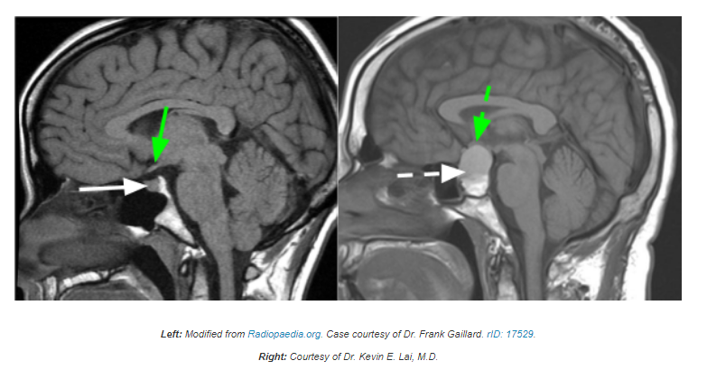
Pituitary Adenoma
Scientists aren’t sure of the exact cause of pituitary adenomas.
But some adenomas have been linked to accidental changes, or mutations in DNA.

Slide 11
Data Description
2
What info do we have?

Slide 12
Our dataset contains more than
7,000
MRI images

Slide 13
These MRI images are divided into four classes:
No tumor
Glioma
Healthy
Malignant (cancerous)
Meningioma
Pituitary
Benign (non cancerous)
Benign (non cancerous)

Slide 14
Some Statistics
3
What do numbers tell us?

Slide 15
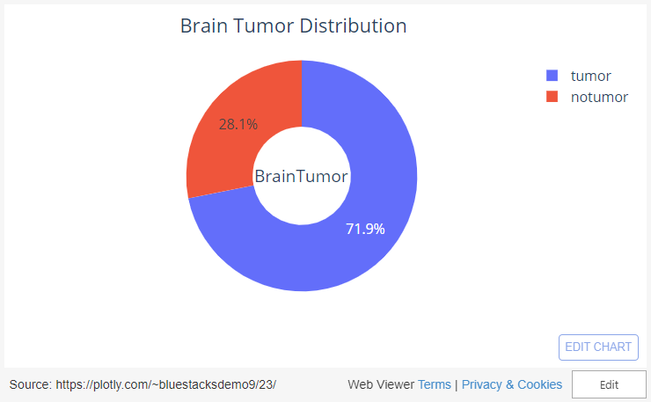
Analyzing a random sample, we found:

Slide 16
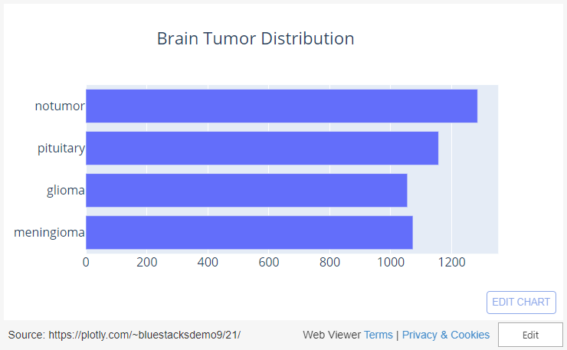
Analyzing a random sample, we found:

Slide 17
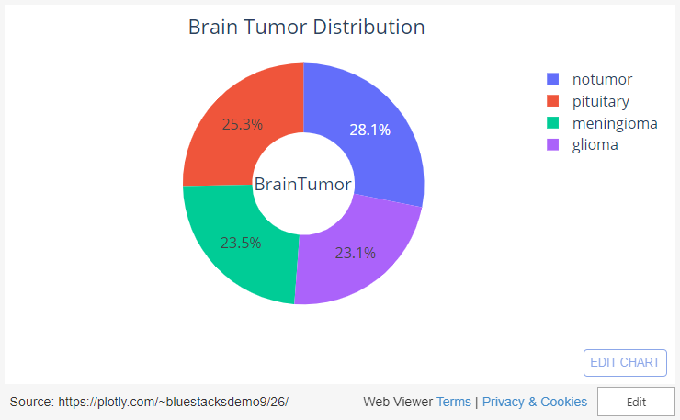
Analyzing a random sample, we found:

Slide 18
Preprocessing & Modeling
4
How did we deal with the all these data?

Slide 19
From the previous EDA, we found that:
Our dataset is balanced.
Image sizes are not the same, so we need to resize them.
We need to convert input images to an array of pixels before feeding them to our model.

Slide 20
Choosing the model:
We had two options:
Create our model from scratch.
Time consuming.
Use a Pre-trained model.
ResNet50
ResNet101

Slide 21
However, We choose:
ResNet50 along with 1 flatten and 2 dense layers.
Takes about 215ms to process one image.
Fairly accurate (94.4% accuracy on test set).
Would not waste our time training it, instead, we train the last 3 layers which we combined with ResNet50.

Slide 22
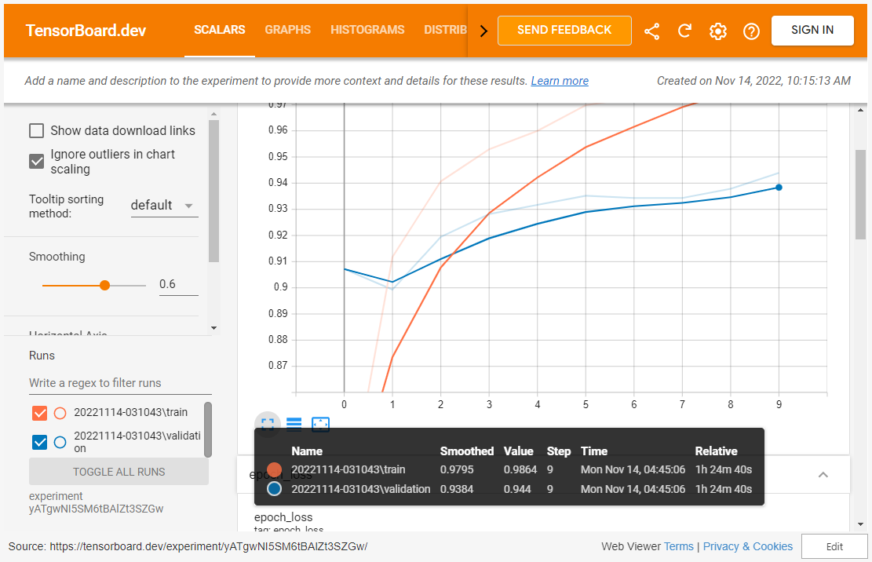

Slide 23
Deployment
5
How can patients benefit from our work?

Slide 24
Brain Tumor Detection
Web App
Can be accessed from anywhere, across all devices.

Slide 25
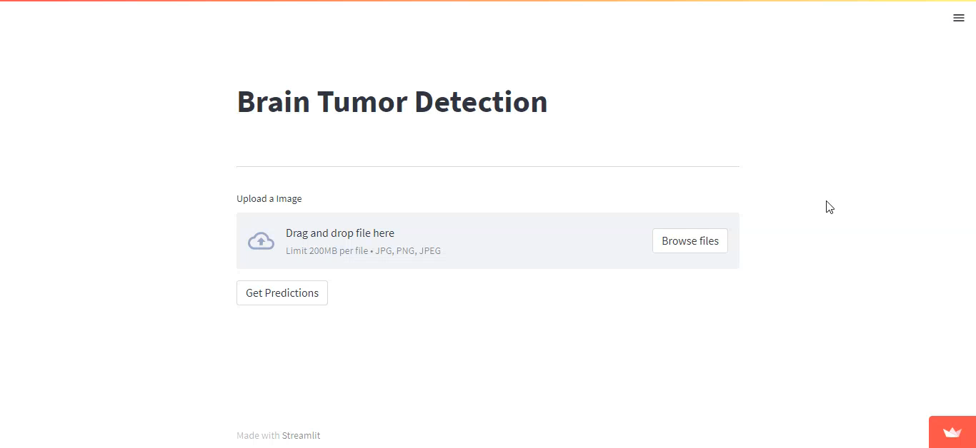

Slide 26
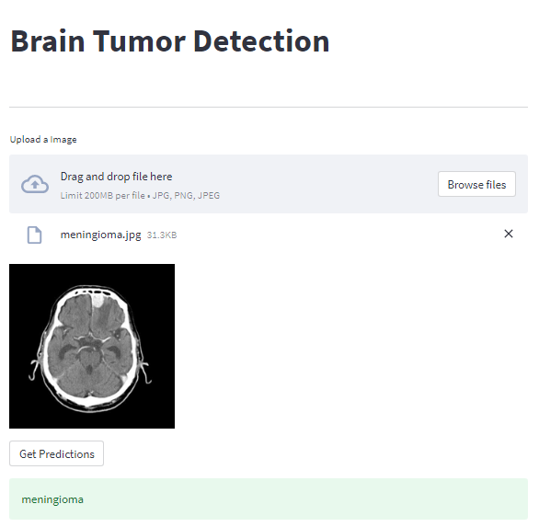
Our web app
Check it out!

Slide 27
Conclusions
6
Final words..

Slide 28



View Source Code

Slide 29
THANKS!
Any Questions?

